Slide 1
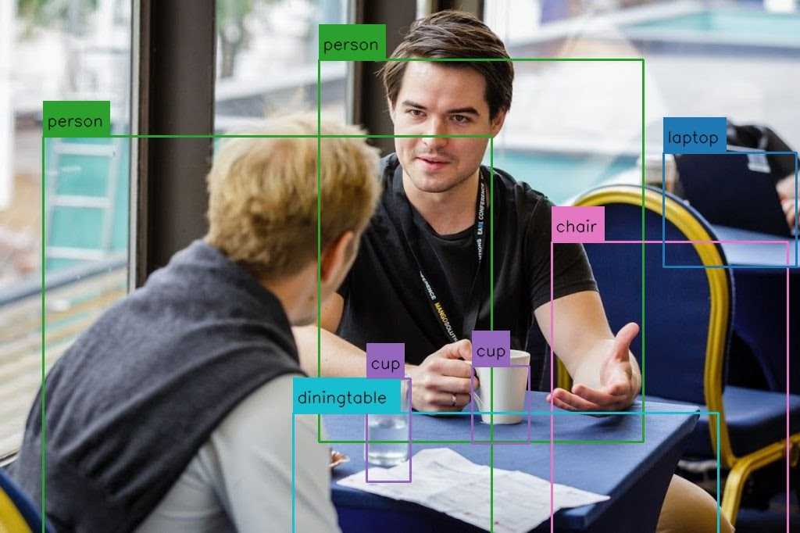
BLIND ASSISTANCE IMAGE TO SPEECH ENGINE
Submitted To : Prof. Hariharan S
Team Members :
18BEC0298 – JAY KISHAN OMAR
18BEC2029 – SAMRIDDH SINGH

Slide 2


Problem Statement
Our project is based on helping blind people to make them know what are the things in front of them. As we all know that blind people can recognize their family members with the help of voice and touch. They can recognize almost all the living things by their voice from a far distance but they can’t recognize non-living objects without touch and feel. That is the case where our project is tend to work. It will recognize all the things in front of them and generate a voice calling their names. Our project can be useful for people with mild or moderate visual impairment by providing the capability to listen to the image. It can also act as a learning aid for people suffering from dyslexia or other learning disabilities that involve difficulty in reading or interpreting words and letters.

Slide 3
Literature Survey
As blind people are not able to read books notes ,They use brails to study for Hard copy of books and Audio Description for PDF's. As audio description help them to access all the data available on internet ,but What about the books which are not available online and the individual wants to read a book available offline. And creating Brail System for a offline book which is quite infeasible as a lot of plates is required.
Blind people face many difficulties which include the recognition of any object or person in front of them. It can be anything like sofa , book , person etc. So we are creating a software which will recognize those object and speak aloud so that blind person may hear it.

Slide 4
WORKFLOW
Gather image data for training CNN model
Train the model to recognize the family members and test it.
Used Yolo object detction for detecting the object in live feed
Used the detected object string in our logic to make recognize the family members
Detect the family member name with the help of CNN model we have train
Now make the user hear the relative name through the speaker using text to speech method
So the audio format file is our final output of the recognition
Now we will make audio of speaking text written on an image
And again we will take image from the webcam and make the written text audible to the user.
Getting the Output

Slide 5

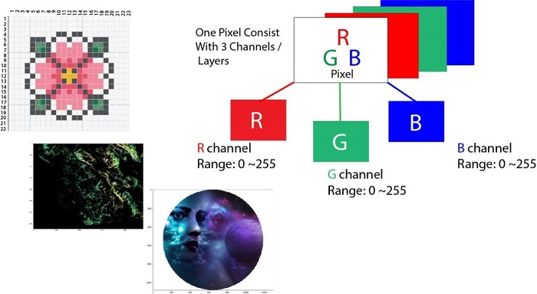
Work Flow
Open CV: CV in the name stands for computer vision. As suggested by the name, Open CV - Python is a library of python bindings designed to reslove computer vision problem. OpenCV - Pyhton makes use of numpy that is a highly optimized library for numericals operations with a MATLB Syntax. All the OpenCV array structures are converted to and from Numpy arrays. This will also help it to integrate with other machine learning mechanism. With the help of OpenCV, we have gathered the images of our hand in form of rock, paper and scissor. For gathering images OpenCV provide us control of using WebCam as we want. For training of model, we wanted to gather images of only hand. OpenCV make the computer to take pictures of only the area inside the recatangle and converted the colour of images and resizing it.

Slide 6
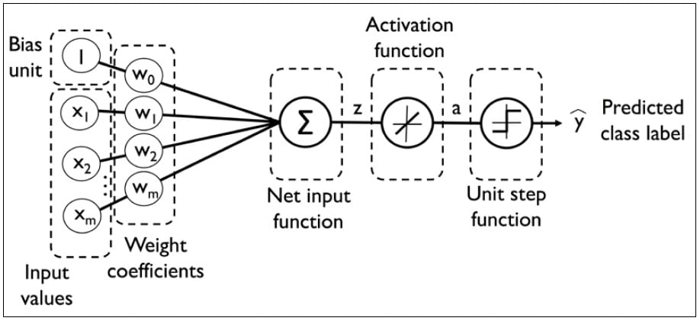
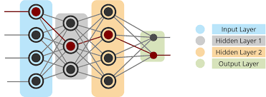
Work Flow
Multi-layer Nueral Network: We can also call it multi-layer perceptron. Perceptron is the basic unit of the nueral network. Perceptron consist of an input, node and output. This complete system makes an perceptron. And if we use many of them inn an line, it makes an nueral layers and if we use many of those layers, it makes an multilayer nueral network. Basically nueral networks make computer learn by the pregiven outputs.
In a perceptron, to predict the output for inputs, it uses activation function.
Activation Function: These are mainly used in each layer of nueral network to introduce non-linearities in the network. There are many activation functions 1) ReLU activation 2) Linear Activation 3) Logistic Activation 4) Sinc Activation and 5) Gaussian Activation etc.

Slide 7
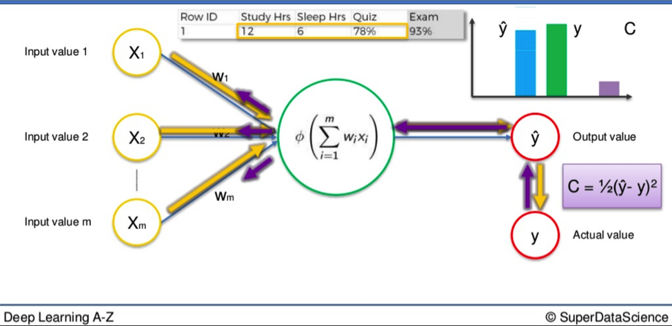
Work Flow
Computer use the neural network for learning the things by the help of error and correction method, also called Back Propagation Algorithm.
Backpropagation Algorithm: This is the technique used for training feedforward neural networks for supervised learning. We can say, it uses a chain rule, after each forward pass through a network, backpropagation performs a backward pass while adjusting the model's parameter (weights).
Steps: Initialize all the weights to small random numbers. Untill satisfied do --
For each training examples do --
a) input the training examples to network and compute the output network.
b) Get the error for the each output unit

Slide 8

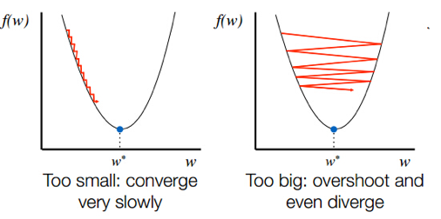
Work Flow
c) calculate the error for each hidden layers.
d) update each network's weight
To update the weights of the each layer, backpropagation use gradient descent theorems.
Gradient Descent: These theorems are used to find the local minima of the error and converges to the solution faster.

Slide 9
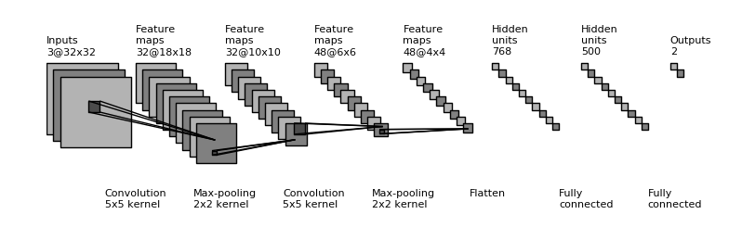

Work Flow
Image Recognition: Convolution Nueral Network is the method to achieve capability for image-recognition.
Convolutional Nueral Network: Convolution networks are simply nueral networks that uses convolution in place of general matrix multiplication in at least on one of their layers. It consist of an input and an output layer,as well as multiple hidden layers. When we pass on an image to the convolution network, the image becomes abstracted to a feature map but in spite of this conversion, it is not fisible to train model as we need more nuerons due to large calculation.
Pooling: The pooling takes small rectangular blocks from the convolutional layers ans subsamples it to produce maximum or average single output from the block.
https://playground.tensorflow.org/#activation=relu&batchSize=10&dataset=spiral&regDataset=reg-plane&learningRate=0.03&regularizationRate=0&noise=0&networkShape=4,3,2&seed=0.10704&showTestData=true&discretize=true&percTrainData=50&x=true&y=true&xTimesY=true

Slide 10
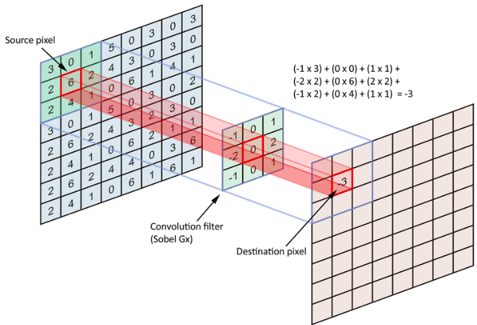
Work Flow
Kernals: In machine learning, a “kernal” is usually used to refer to the kernel trick, a method of using a linear classifier to solve a non-linear problem. Basically it is a filter that is used to extract the features form the images. The keranl is a matrix that moves over the input data, performs the dot product with the sub-region of the input data, and gets the output as the matrix dot products. It is used to extract high level features from the images like edges from the images.
https://setosa.io/ev/image-kernels/

Slide 11
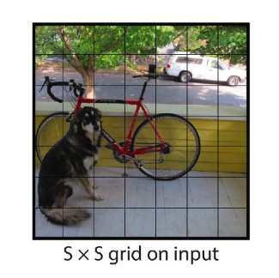
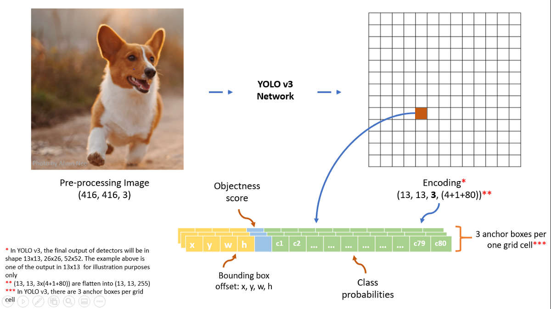
Work Flow
YOLO Object Detection: Our network uses features from the entire image to predict each bounding box. It also predicts all bounding boxes across all classes for an image simultaneously. This means our network reasons globally about the full image and all the objects in the image. The YOLO design enables end-to-end training and realtime speeds while maintaining high average precision.
Our system divides the input image into an S × S grid. If the center of an object falls into a grid cell, that grid cell is responsible for detecting that object.
Each grid cell predicts B bounding boxes and confidence scores for those boxes. These confidence scores reflect how confident the model is that the box contains an object and also how accurate it thinks the box is that it predicts. Formally we define confidence as Pr(Object) ∗ IOU.

Slide 12
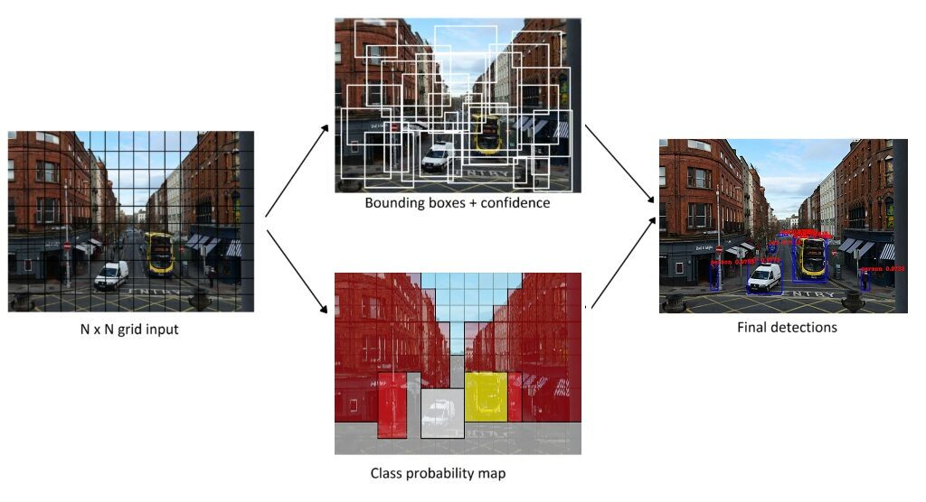

Work Flow
If no object exists in that cell, the confidence scores should be zero. Otherwise we want the confidence score to equal the intersection over union (IOU) between the predicted box and the ground truth
Each bounding box consists of 5 predictions: x, y, w, h, and confidence. The (x, y) coordinates represent the center of the box relative to the bounds of the grid cell. The width and height are predicted relative to the whole image. Finally the confidence prediction represents the IOU between the predicted box and any ground truth box. Each grid cell also predicts C conditional class probabilities, Pr(Classi |Object). These probabilities are conditioned on the grid cell containing an object. We only predict one set of class probabilities per grid cell, regardless of the number of boxes B.
At test time we multiply the conditional class probabilities and the individual box confidence predictions,
Pr(Classi|Object)∗Pr(Object)∗IOU = Pr(Classi)∗IOU

Slide 13
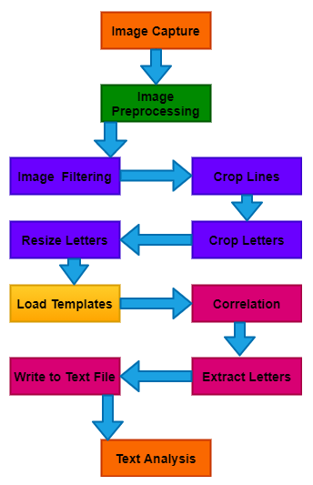
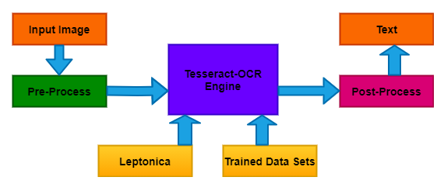
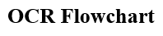
BLOCK DIAGRAM

Slide 14
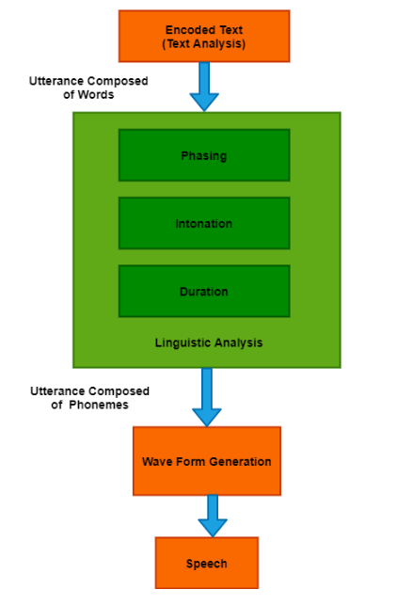
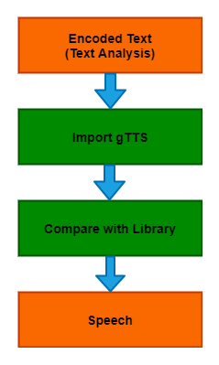
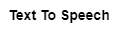

Slide 15
STEPS
Pre-Processing
Feature Extraction
Post Processing
De-Skew, Despeckle, Binarization, Line Removal, Zoning, Word Detection, Script Detection, Segmentation, Normalization
Pattern Recognition, Feature Detection

Slide 16
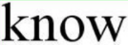


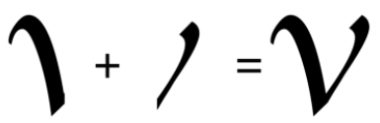
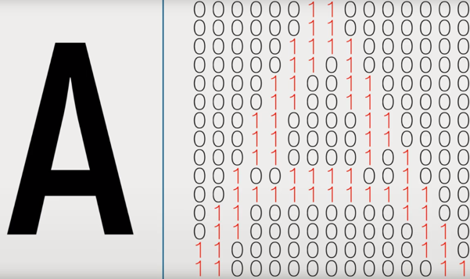

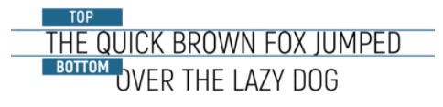
VISUAL REPRESENTATION OF STEPS

Slide 17
PROCESSING OF THE RECOGNISED DATA
Pre-Processing:
This is done to boost the chances of recognition of an text-images. Technique used –
De-Skew→
If the document was not correctly aligned when scanned, it may need to be titled a few degrees clockwise or counterclockwise to create text-lines completely horizontal or vertical.
Despeckle→
Remove positive and negative spots, smoothing edges.
Binarization→
Convert an image to black and white (binary image 2 colors only used). The binarization task is conducted as an easy and accurate way to distinguish text from background.

Slide 18
Line Removal→
Cleans up non-glyph boxes and lines.
Layout Analysis / Zoning→
Identifies columns, paragraphs, captions etc. as blocks. (Multi-columns layout tables)
Line and Word Detection→
Establish word and character shapes baseline, divide words when required.
Script Recognition→
In multiple language documents, the script may transform the word level and therefore script identification is vital before the relevant OCR to manage the particular script.
Segmentation / Character Isolation→
Various character linked by image artifacts should be divided, single characters broken into several artifacts-based pieces should be linked.
Normalization→
Normalize the aspect ratio and scale.

Slide 19
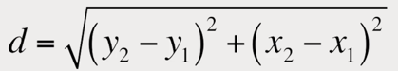
Feature Extraction:
There are two main methods for extracting features in OCR.
The algorithm for feature detection defines a character by evaluating its lines and strokes.
Pattern recognition works by identifying the entire character.
We can recognize a line of text by searching or white pixel rows that have black pixels in between. Similarly where character starts and ends.
Next convert the image of the character into a binary matrix where white pixels are 0s and black pixels are 1s.
Then, by using the distance formula, we can find the distance from the center of the matrix to the farthest1.
We can create a circle of that radius and split it up into more granular sections.

Slide 20
At this stage the algorithm compares each subsections to a database of the matrices representing characters with different fonts to identify the characters it has most in common statistically.
It makes easy to bring printed media into digital world by doing this for every line and character.
Post-Processing:
OCR accuracy can be improved if the output is limited by a lexicon (a list of words permitted in a document).
This method can be less efficient if the document contains words that are not in the lexicon, like proper nouns.
To improve this we are using OCR library which are open source which is used to control the segmentation of the characters.
The output stream can be a single string or a characters file.
Error Correction:
The ‘nearest neighbor’ can use frequencies for co-occurrence to correct mistakes by nothing that some words has been together.

Slide 21
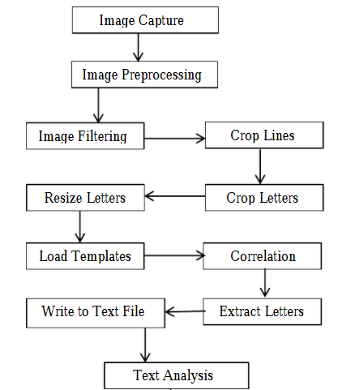
Methodology
Camera will help to take picture or for live video-capturing. The images captured by camera is feeded into the YoloObject detection model that will saperate the different objects from the image and tell their names with a image with proper border saperating them. Then we feed these names to the text to speech engine that will turn the text to audio and the person will be able to hear the audio almost in real time. As this is for the one purpose.
The other purpose of our projct is educational. We will also worl on a system that will convert pdf file to the audio. We will do this by uploading PDF or any other form of document to OCR API and the praised text will be in in the form of JAVA SCRIPT OBJECT NOTATION which will be called by the API key and will work as Audio Description using Text-To-Speech ,And for reading live books ,templates and Images.

Slide 22
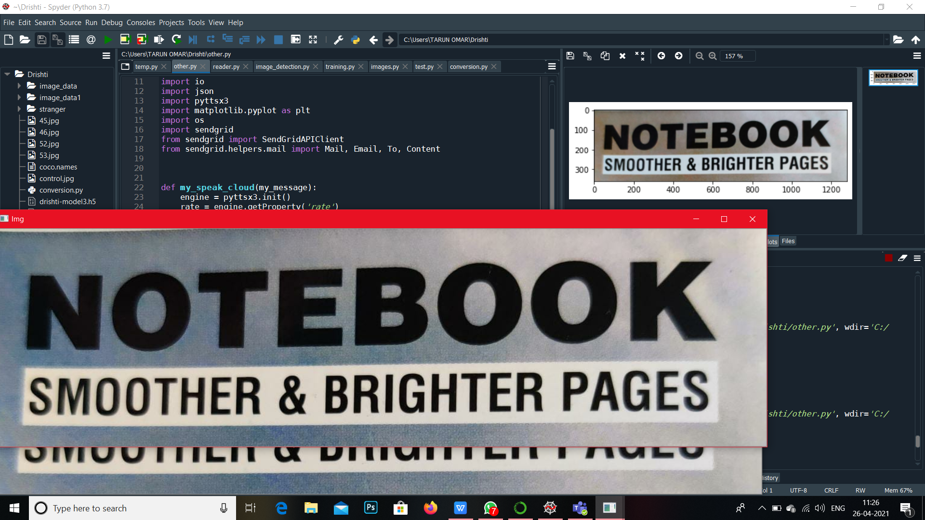
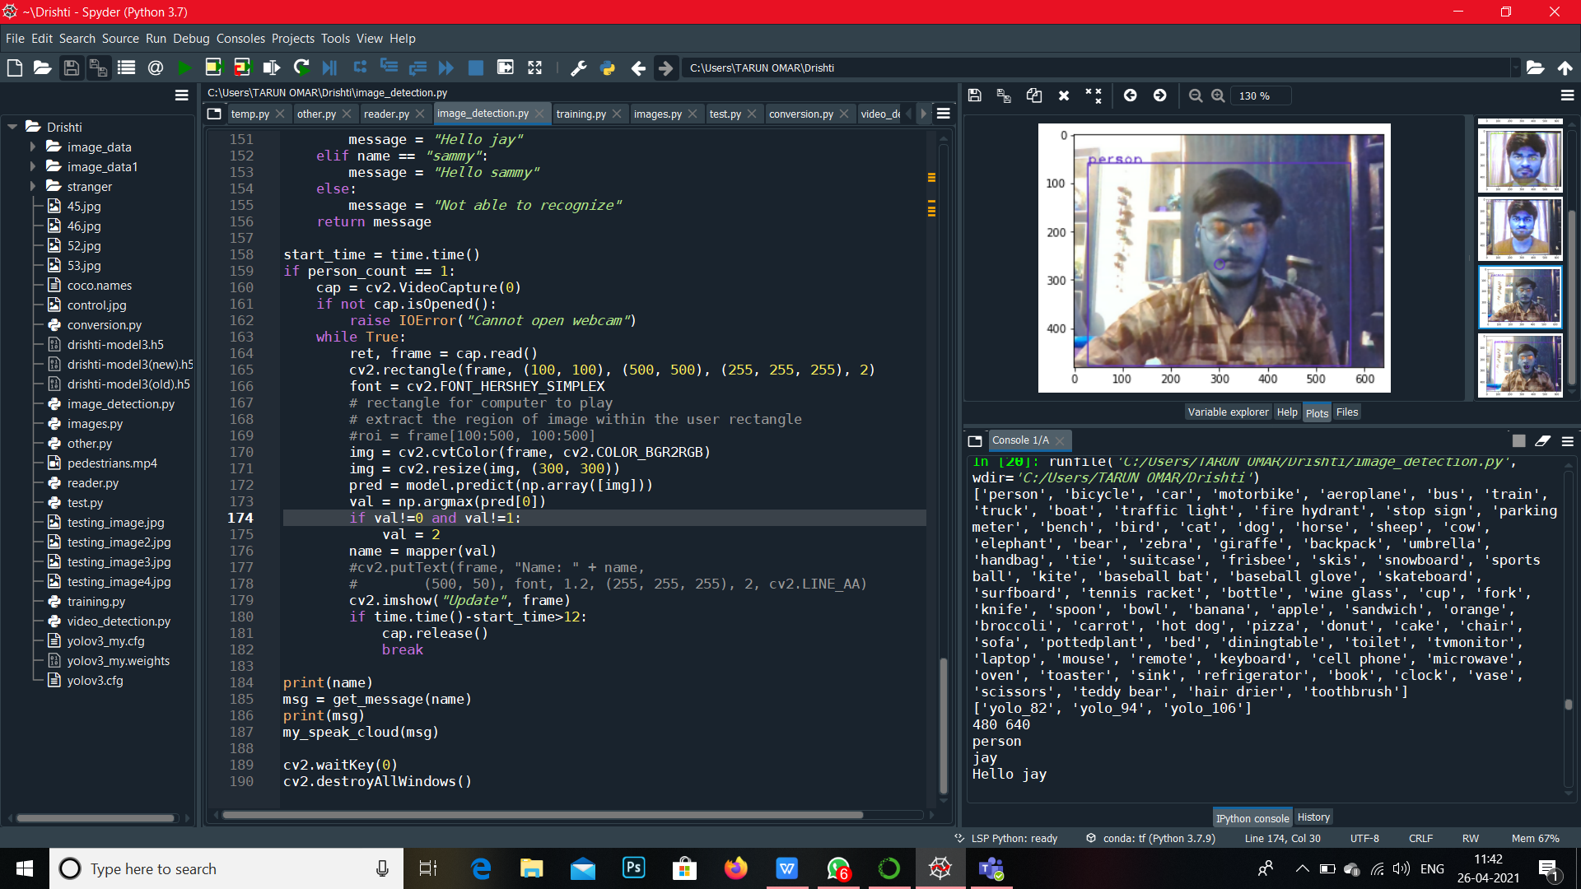
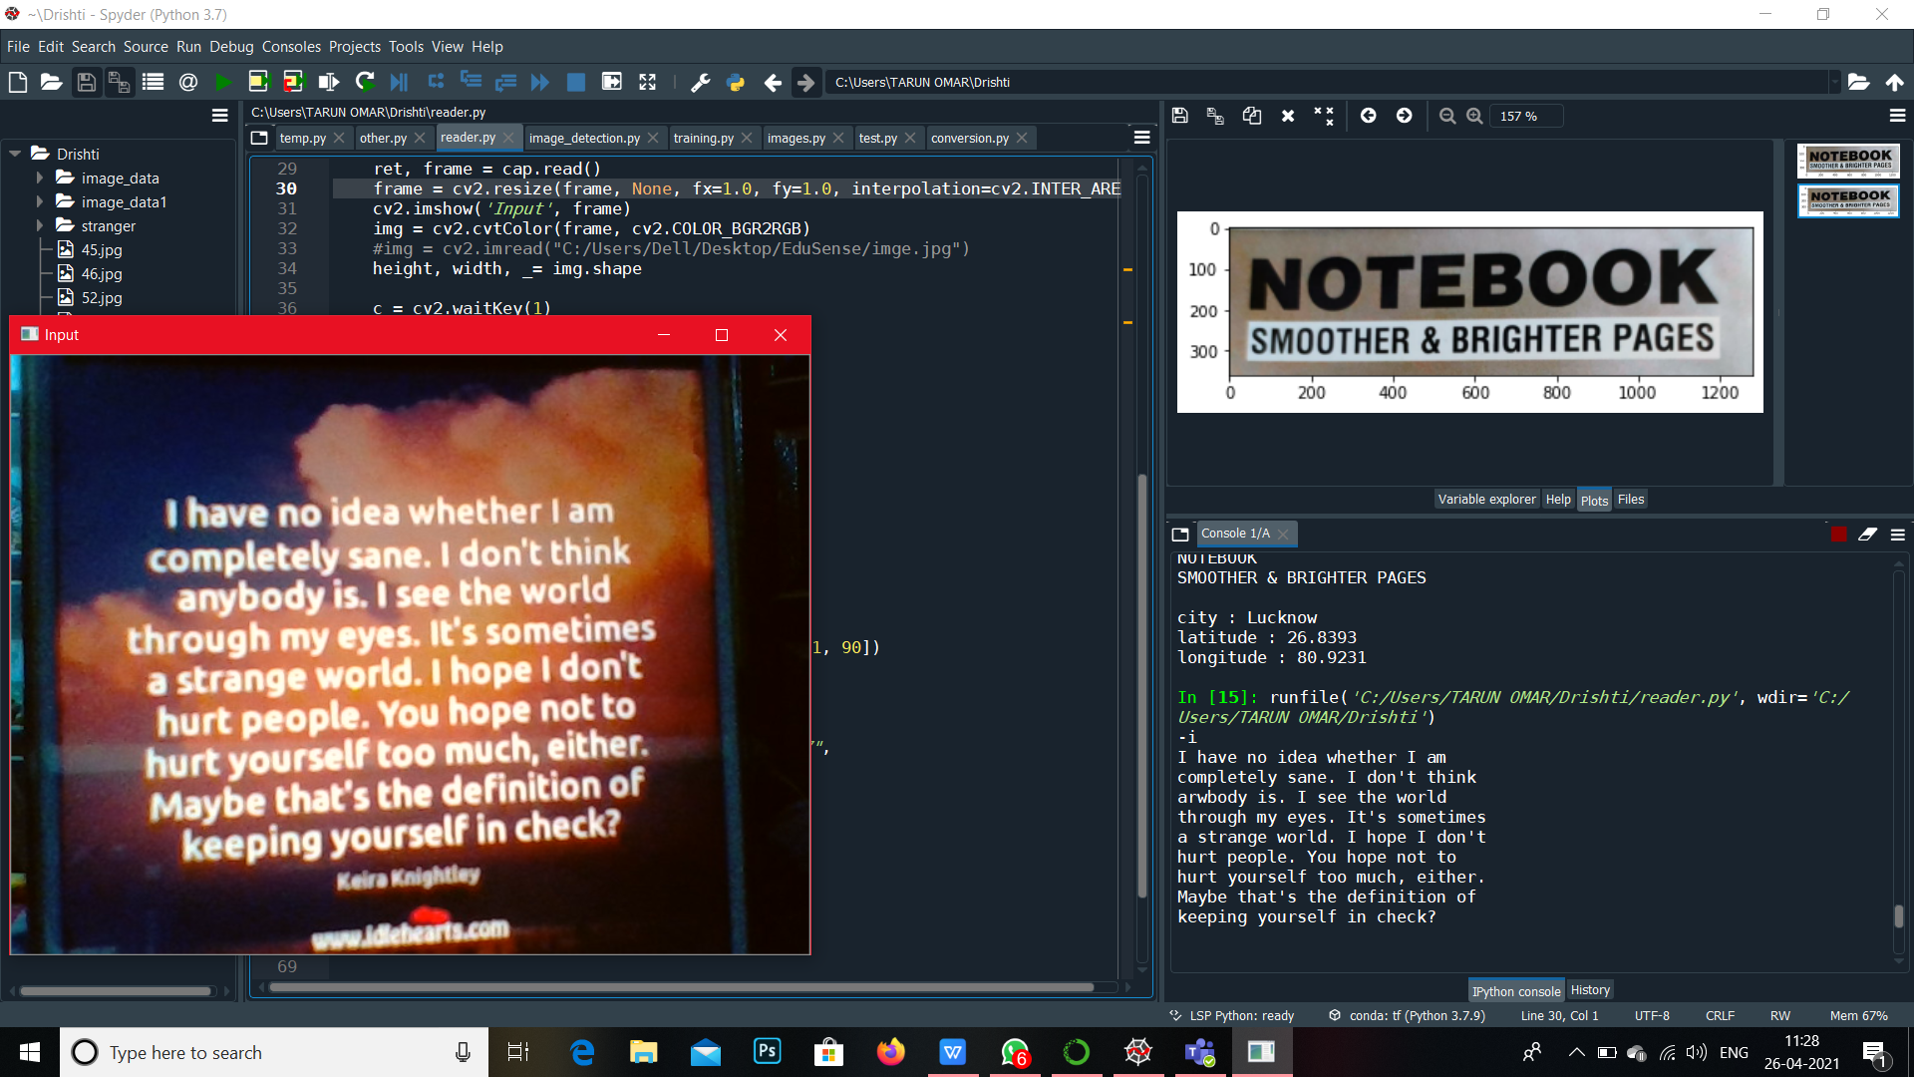
RESULT

Slide 23

Technology Used
Pycharm Software
Spyder Software
Open CV
Online Platform (api.ocr.space)
Google text to speech (Gyttx)
Python text to speech (pyttx)
YOLO object detection
Speaker and Camera

Slide 24
Timeline
S.No | Month | Work to be done
1. | Febuary | We will try to collect all the details about our project and try to understand those thoroughly.
2. | March | We will be doing the object detection part of our project using any model that is most accurate and easy to implement.
3. | April | We will be doing the optical character recognition part of our project for the various objectives.
4. | May | We will be doing CNN part and merging all the parts together in one application.

Slide 25
REFERENCES
https:/researchgate.net/publication/326224279_Text-to-Speech_Device_for_Visually_Impaired_People
https:/acadpubl.eu/jsi/2017-117-20-22/articles/21/16.pdf
www.researchgate.net/publication/282268546_Text_to_Speech_Conversion_System_using_OCR
https://www.google.com/search?q=text+to+speech+for+blind
https://machinelearningmastery.com/how-to-perform-object-detection-with-yolov3-in-keras/
Ahmad, Tanvir & ma, Yinglong & Yahya, Muhammad & Ahmad, Belal & Nazir, Shah & Haq, Amin & Ali, Rahman. (2020). Object Detection through Modified YOLO Neural Network. Scientific Programming. 10.1155/2020/8403262.

Slide 26
Thank You
COVID 19

